Slide 1

Data Visualization of Bird Strikes
WIREFRAME
By Himasree Ramini

Slide 2
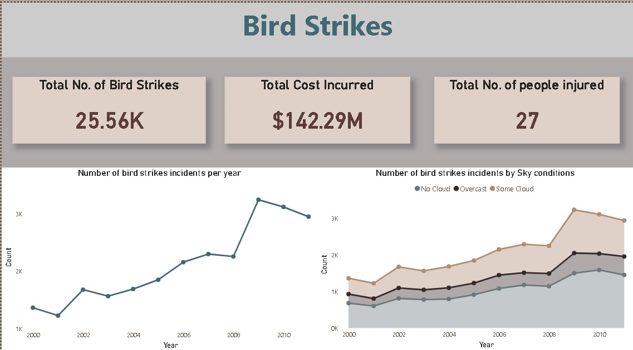
Dashboard

Slide 3
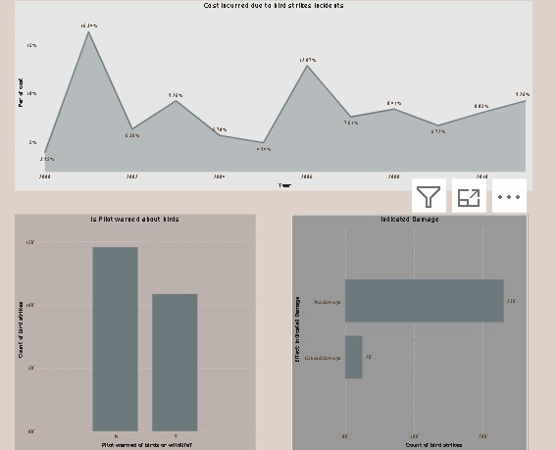
Flight Insights:

Slide 4
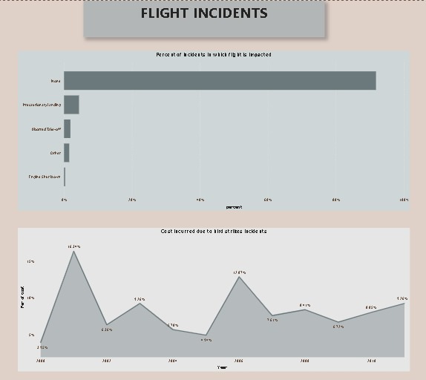
Cost Incursion:

Slide 5
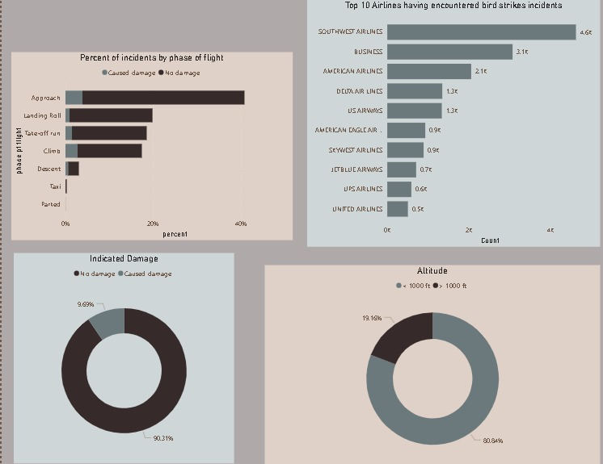
Top 10 airlines having encountered bird strikes:

Slide 6
Conclusion :
Many airlines follows and takes the precautions accurately to avoid accidents from the birds.
Total No. of bird strikes annually takes place is 25.56k ,the cost incurred is $142.49M and no.of people injured is 29.

